Slide 1
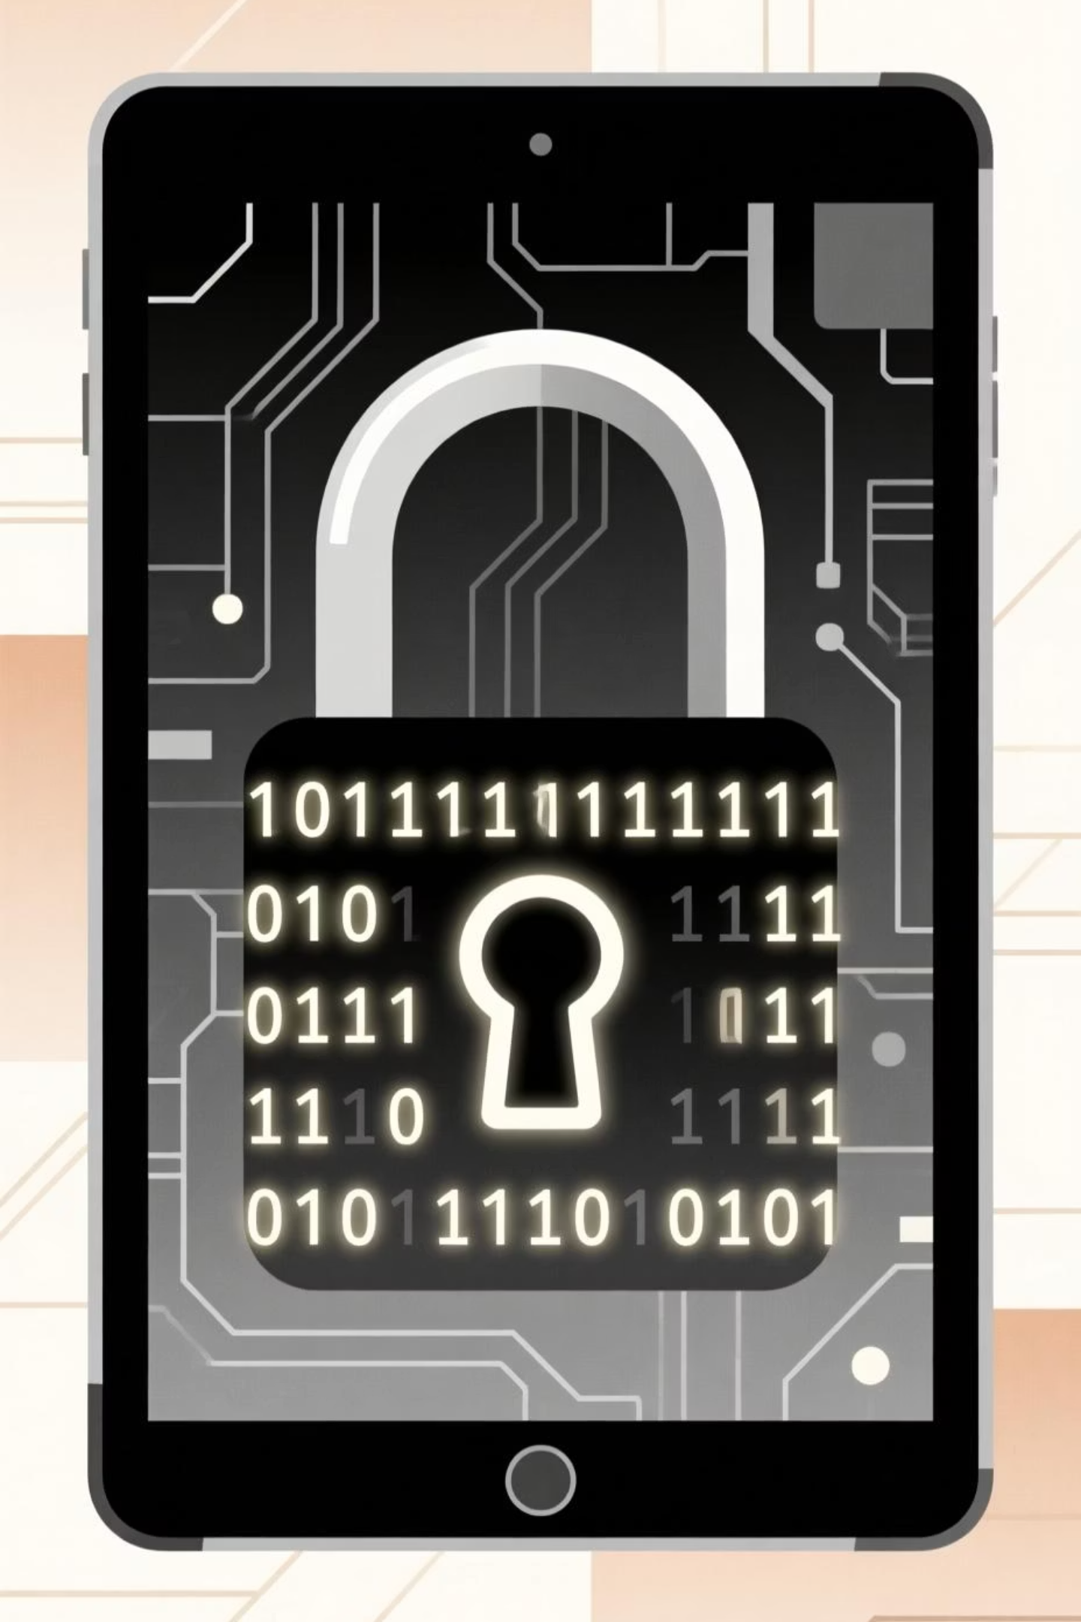
Cyber Hygiene: Stay Safe Online Every Day

Slide 2
Why Cyber Hygiene Matters
1
2
3
Universal Threat
Data Protection
Risk Reduction
Cyber threats target everyone, not just tech experts. No one is immune to online risks.
Simple habits protect your personal information and sensitive company data from unauthorized access.
Good cyber hygiene significantly reduces your risk of falling victim to scams, hacks, and devastating data loss.

Slide 3
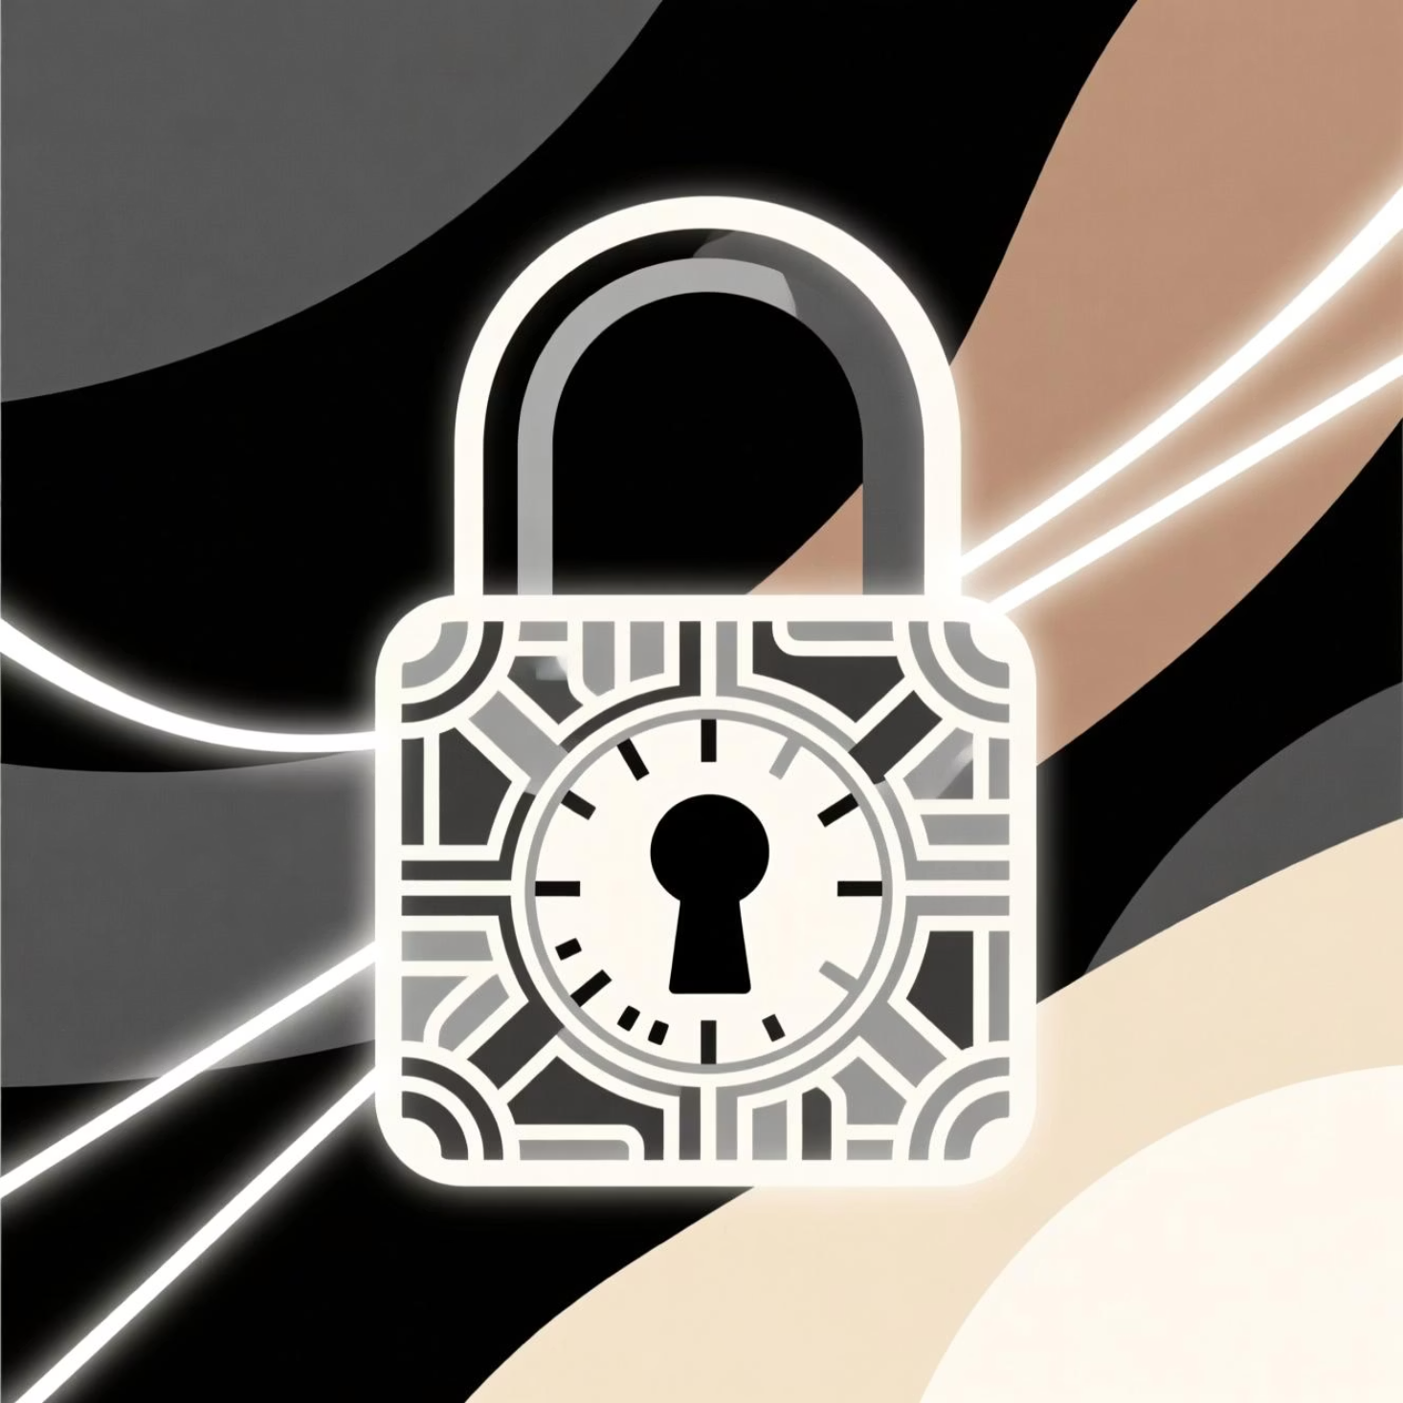
Use Strong, Unique Passwords
Your password is your first line of defense. Don't make it easy for hackers!
Avoid common or reused passwords across different accounts. Each account needs its own unique key.
Use a reliable password manager to create, store, and manage complex passwords securely. It's like a vault for your digital keys.
Consider a memorable passphrase: Combine 3 random, unrelated words (e.g., "blue-elephant-cloud") or a phrase only you understand.

Slide 4



Enable Two-Factor Authentication (2FA)
Extra Layer of Security
Blocks Unauthorized Access
Easy to Use
Utilize authentication apps like Google Authenticator or Microsoft Authenticator, or rely on SMS codes for convenient security.
2FA adds a critical second verification step beyond just your password, usually a code sent to your phone or generated by an app.
Even if a hacker manages to steal your password, they can't access your account without that second factor.

Slide 5
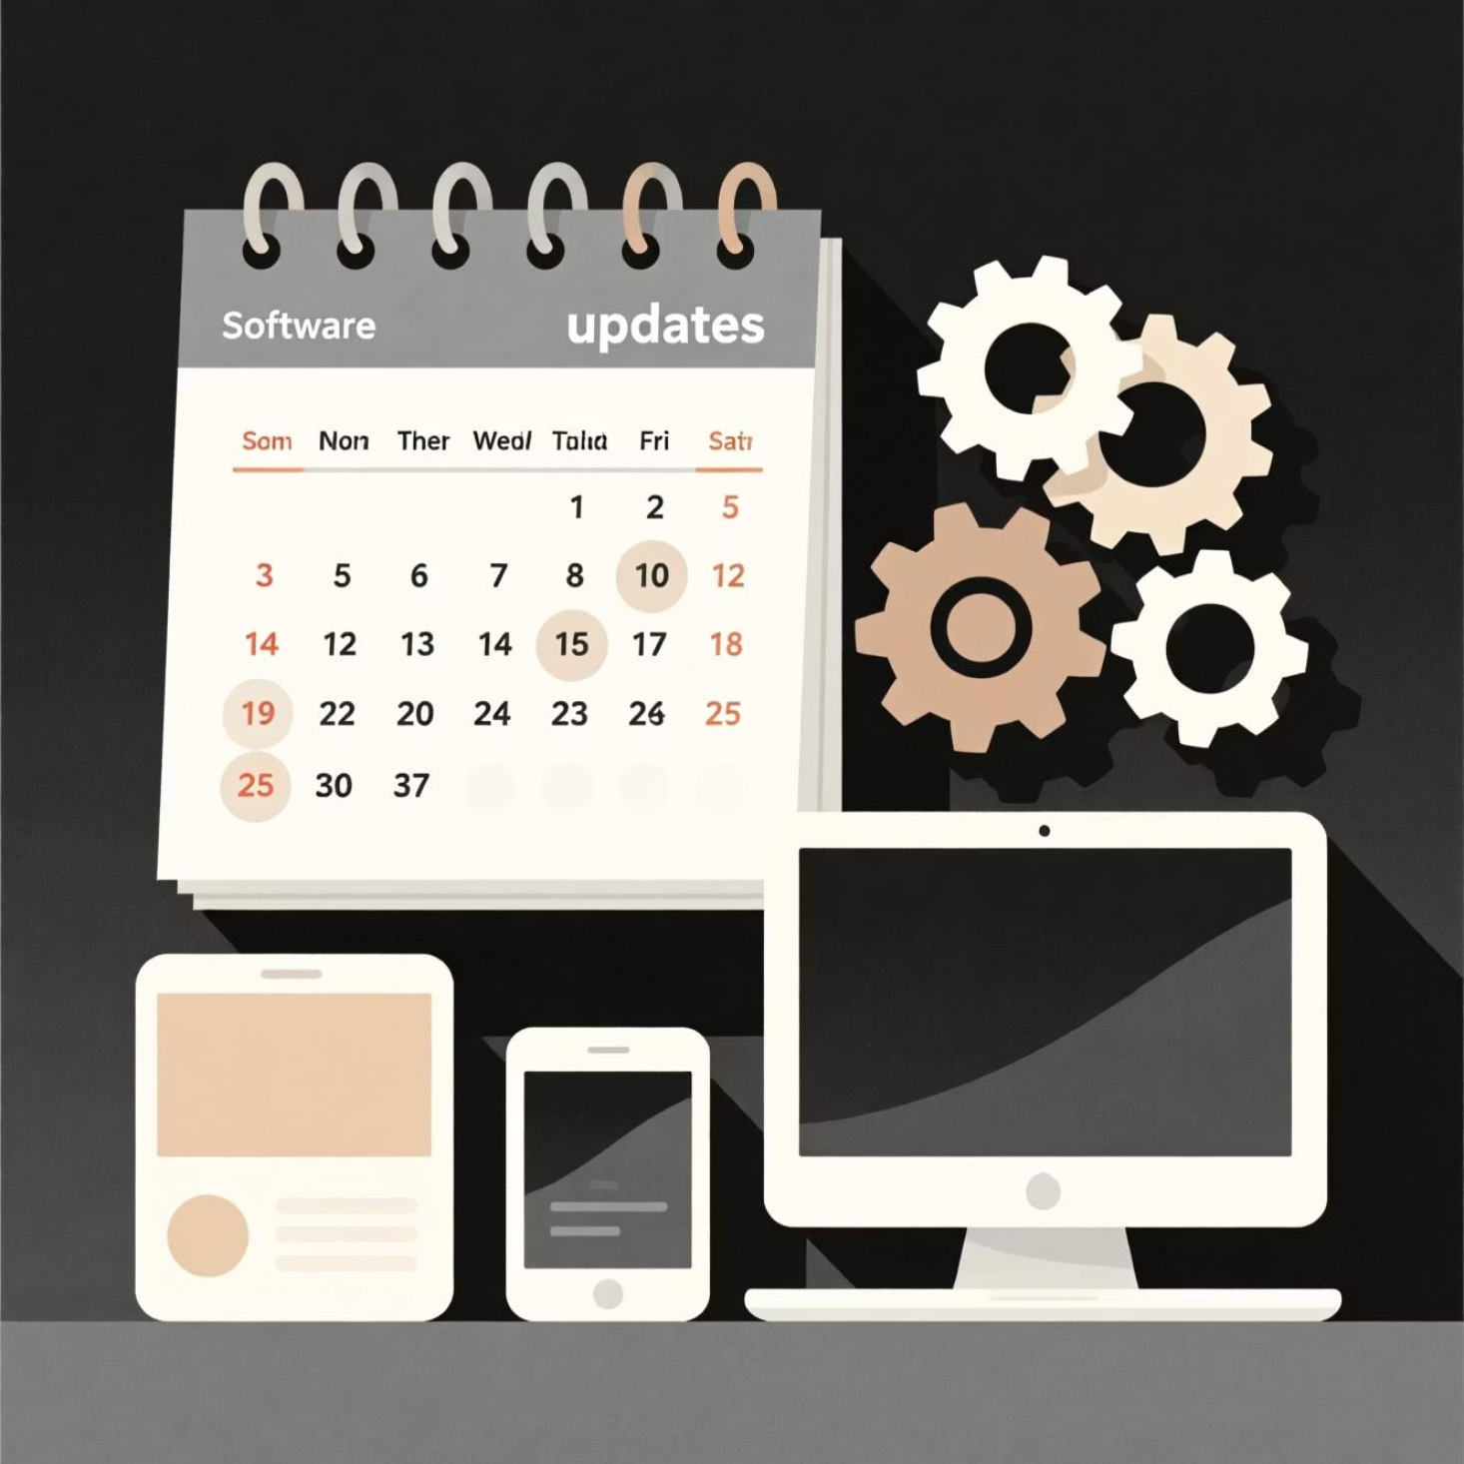
Keep Software and Devices Updated
Outdated software is an open door for cybercriminals. Keep everything fresh and patched.
Updates aren't just for new features; they patch security vulnerabilities that hackers actively seek to exploit.
Enable automatic updates for your operating systems (Windows, macOS, iOS, Android), web browsers, and all your applications.
Never delay installing important security patches. They often contain critical fixes for newly discovered threats.

Slide 6



Think Before You Click
Suspicious Communications
Beware of unexpected emails, links, and attachments, especially if they create a sense of urgency or offer something too good to be true.
Phishing Scams
Phishing attempts are designed to trick you into revealing personal information like passwords or to install malicious software (malware).
Verify and Be Cautious
Always verify the sender's identity and the legitimacy of links before clicking. Never share sensitive information via email or unsecured messages.

Slide 7
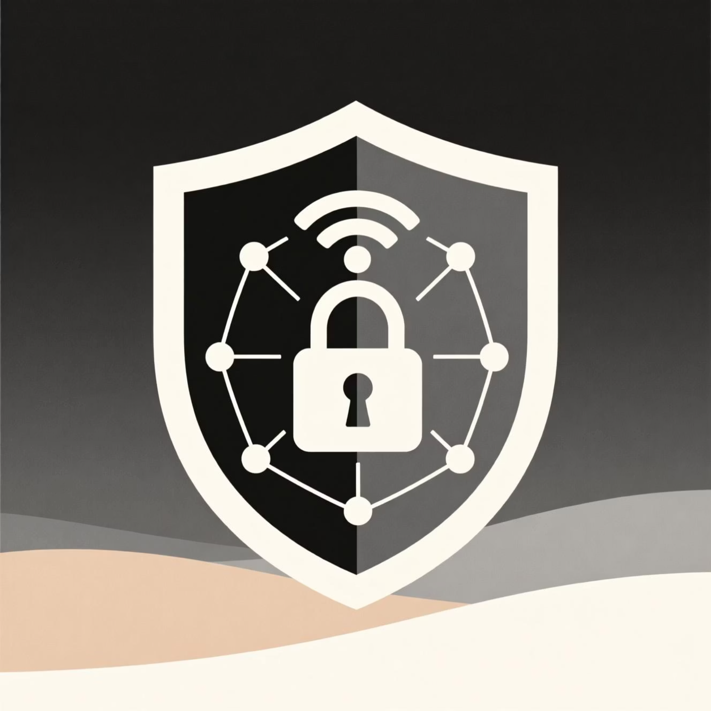
Secure Your Wi-Fi and Networks
Strong Wi-Fi Passwords: Ensure your home and work Wi-Fi networks are protected with strong, unique passwords. Change default router credentials immediately.
Public Wi-Fi Caution: Avoid conducting sensitive tasks (like banking or online shopping) on public Wi-Fi. If you must use it, use a trusted Virtual Private Network (VPN) for encryption.
Hide Your Network: For added security, consider hiding your Wi-Fi network's name (SSID). This makes it less visible to casual scanners.

Slide 8
Bonus: Back Up Your Important Data Regularly
Safeguard Your Files
Multiple Backup Options
Automate for Peace of Mind
Regular backups are essential to protect your valuable files from accidental deletion, hardware failure, or destructive ransomware attacks.
Utilize reliable cloud storage services (e.g., Google Drive, Dropbox) or external hard drives for secure, off-site storage.
Set up automatic backups for your critical data. This ensures your information is consistently protected without manual effort.

Slide 9
Stay Cyber Safe — Protect Yourself and Your Workplace
Cyber hygiene is simple but powerful.
Your actions make a real difference in stopping cybercrime and protecting our shared digital environment.
For any questions or further assistance, don't hesitate to contact your IT or security team. They are there to help you.
Together, we keep our digital world secure!

